Slide 1
Securing constructing bar charts by hand
Graphical representations of data

Slide 2
how to use Oak lessons

Slide 3
I can construct bar charts from data.

Slide 4
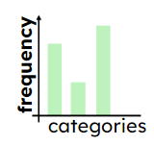
The frequency is the number of times an event occurs; or the number of individuals (people, animals etc.) with some specific property.
A bar chart (bar graph) is a graph consisting of bars visually representing the frequency of objects or groups.
Data are a collection of information.

Slide 5

Securing constructing bar charts by hand
Constructing and interpreting bar charts
Using bar charts in a data investigation

Slide 6


Constructing and interpreting bar charts
Bar charts
This is a pictogram showing merits collected by our class.
4
8
12
16
20
24
Week 1
Key
= 4 merits
Week 2
Week 3
I put the multiples of the key along the top, then it is easier to count.
Week 4
Week 5
Alex

Slide 7

Constructing and interpreting bar charts
24
Alex’s pictogram, it looks like a bar chart!
20
16
12
8
4
Izzy
Week 1
Week 2
Week 3
Week 4
Week 5

Slide 8
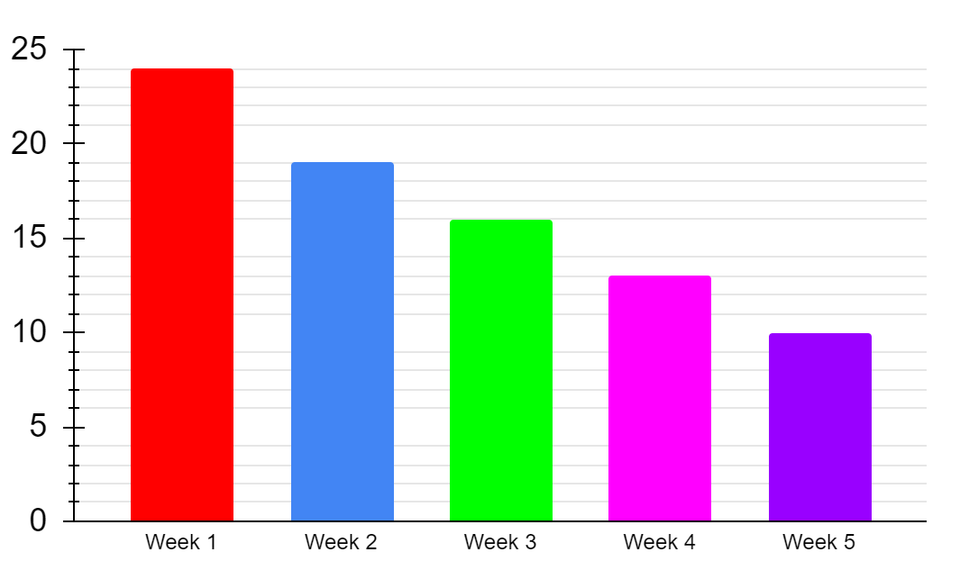
Constructing and interpreting bar charts
24
20
Frequency
16
12
8
4
Week 1
Week 2
Week 3
Week 4
Week 5
What are the features of a bar chart?
The vertical axis shows the frequency. (On a horizontal bar chart frequency will be on the horizontal axis instead.)
The bars are the same width.
There are equal gaps between the bars.

Slide 9
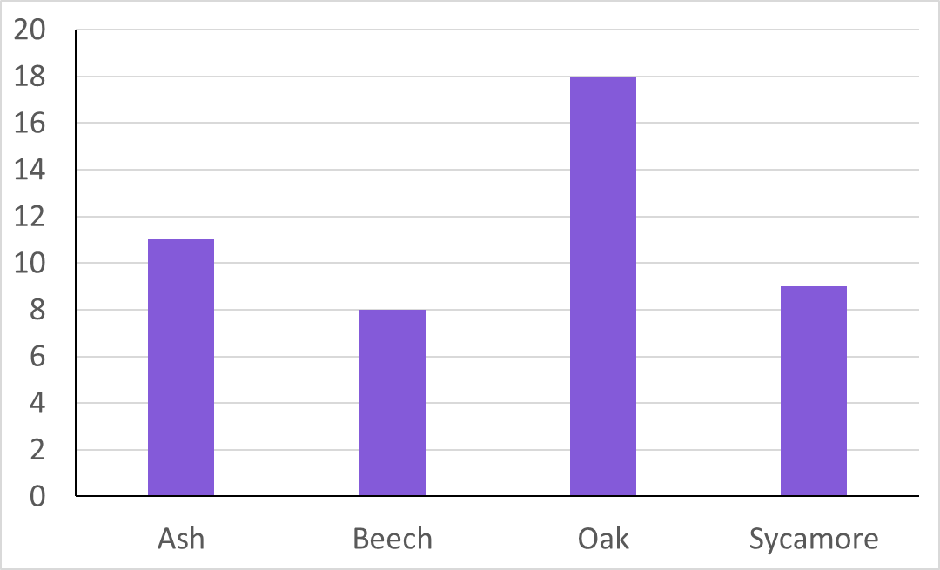
Constructing and interpreting bar charts
Fill in the label.
Frequency
Type of tree

Slide 10
Constructing and interpreting bar charts
How many sycamore trees were there in this woodland?
Frequency
9 sycamore trees
Type of tree

Slide 11
Constructing and interpreting bar charts
The vertical axis on a bar chart is the frequency.
Choosing the scale is very important.
London Airports | frequency
Gatwick | 2
Heathrow | 4
Luton | 1
Stansted | 1
This data is about the number of terminals at four London airports.
What scale would you use on the vertical axis for this data?
The greatest number is 4, so going up in ones would be fine.

Slide 12
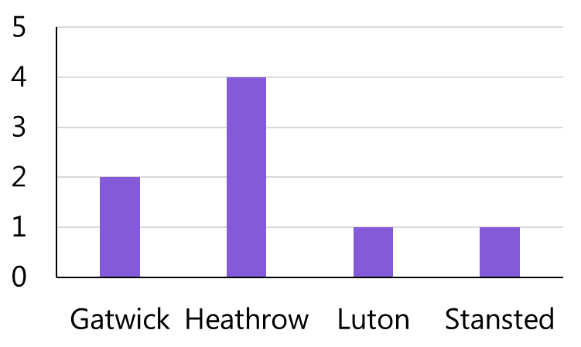
Constructing and interpreting bar charts
Number of terminals at four London airports
Frequency
Airports

Slide 13
Constructing and interpreting bar charts
The vertical axis on a bar chart is the frequency.
Choosing the scale is very important.
London Airports | frequency
Gatwick | 49
Heathrow | 82
Luton | 8
Stansted | 17
This data is about the number of airlines at four London airports.
What scale would you use on the vertical axis for this data?
Depending on space you could go up in 4s but you could go up in 10s.

Slide 14
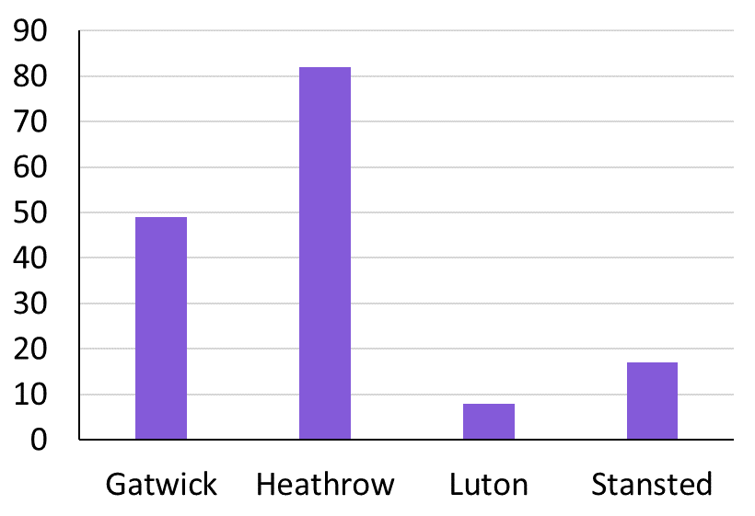
Constructing and interpreting bar charts
Number of airlines at four London airports
Frequency
Airports

Slide 15
Constructing and interpreting bar charts
The vertical axis on a bar chart is the frequency.
Choosing the scale is very important.
London Airports | frequency
Gatwick | 190
Heathrow | 224
Luton | 126
Stansted | 195
This data is about the number of destinations served by four London airports.
What scale would you use on the vertical axis for this data?
The greatest number is 224 and the lowest is 126, that is nearly 100 different. You could go up in steps of 25.

Slide 16
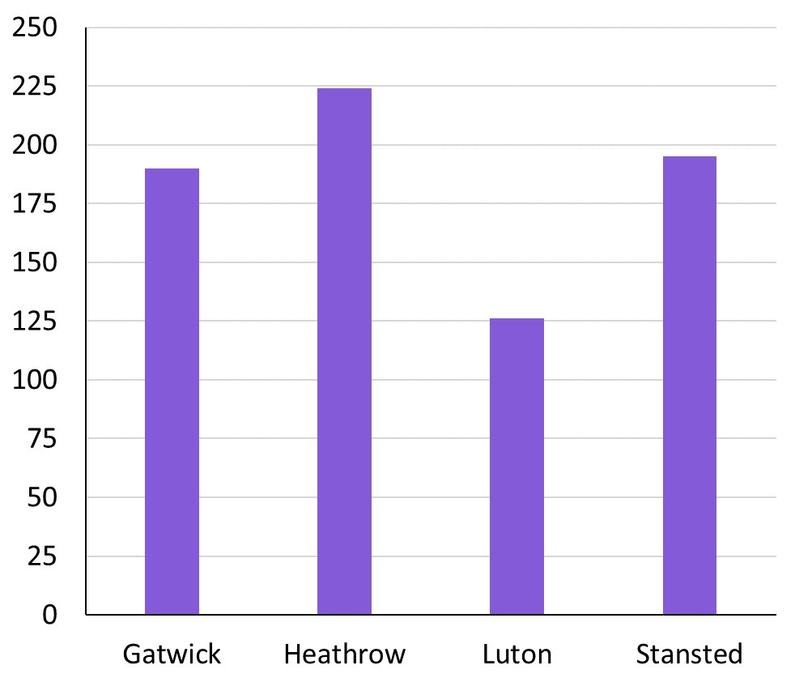
Constructing and interpreting bar charts
Number of destinations travelled to by four London airports
Frequency
Airports

Slide 17
Constructing and interpreting bar charts
Why would having a vertical scale which increases by 1 each time not be advisable for this data?
books | number of pages
book 1 | 73
book 2 | 49
book 3 | 58
book 4 | 37
You may have considered:
It would take up a lot of space.
The data ranges between 37 and 73.

Slide 18
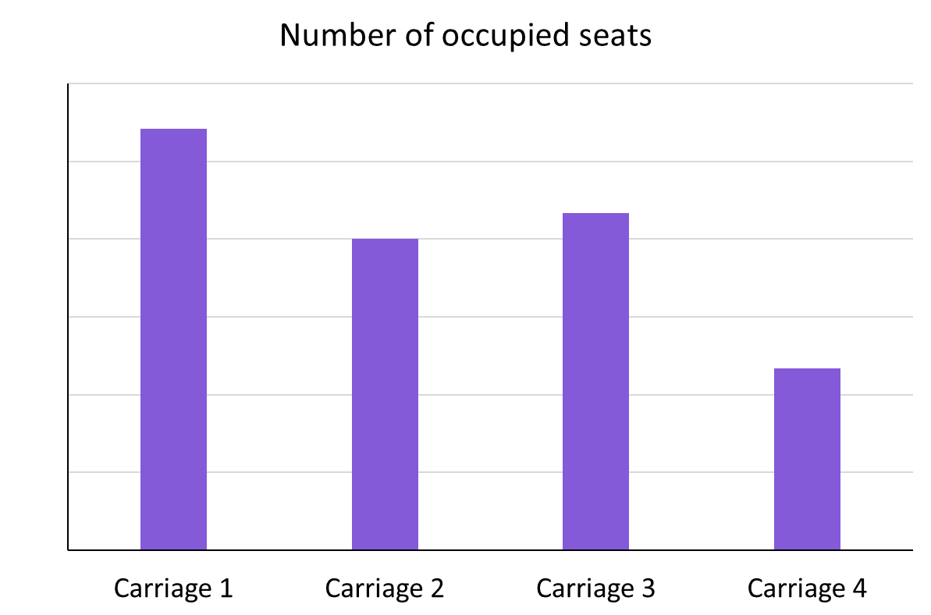
Constructing and interpreting bar charts
Complete the vertical scale.
48

Slide 19
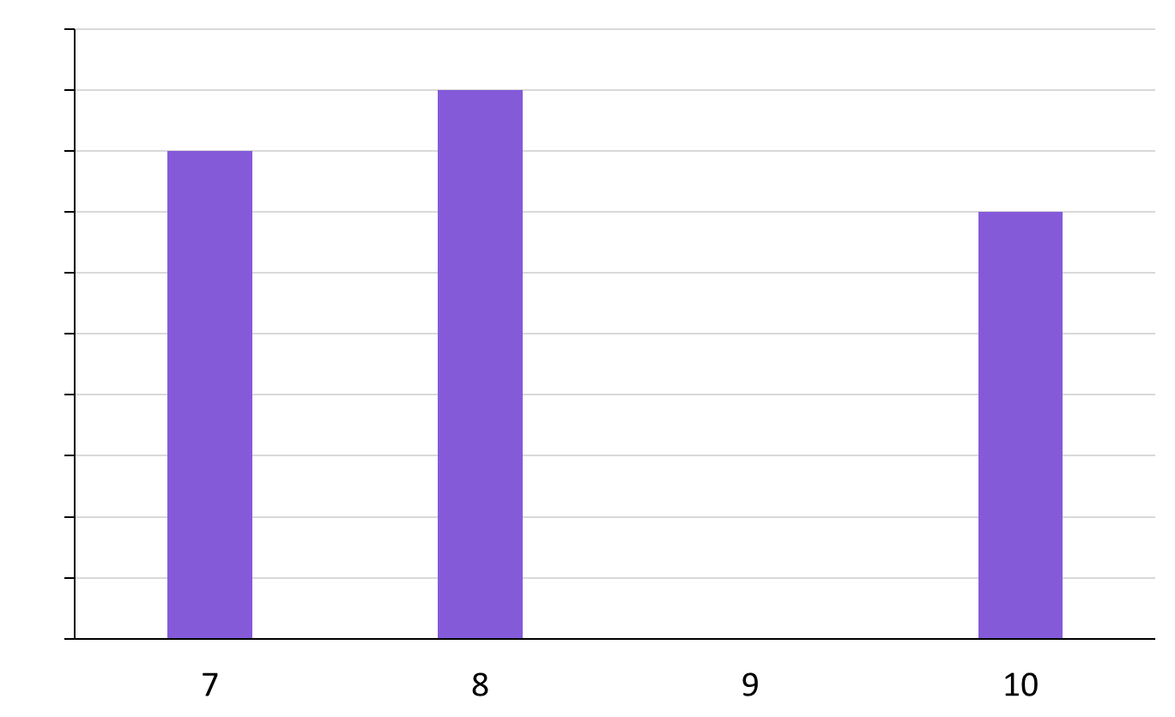
Constructing and interpreting bar charts
Complete the frequency table and bar chart.
sweets per pack | frequency
7 | 16
8
9 | 17
10 | 14
Sweets per pack

Slide 20
Constructing and interpreting bar charts
Complete the vertical scale.
72
Frequency
60
48
36
24
12

Slide 21
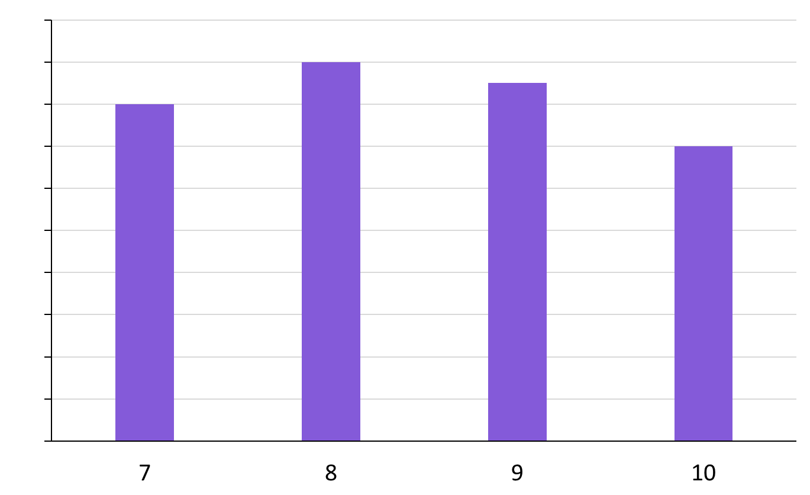
Constructing and interpreting bar charts
Complete the frequency table and bar chart.
20
sweets per pack | frequency
7 | 16
8 | 18
9 | 17
10 | 14
18
Frequency
16
14
12
10
8
6
4
2
Sweets per pack

Slide 22
Securing constructing bar charts by hand
Constructing and interpreting bar charts
Using bar charts in a data investigation

Slide 23




Using bar charts in a data investigation
A local authority want to know if secondary school students are eating the recommended five portions of fruit and vegetables a day.
They collect data from the four similarly sized secondary schools in the area about how many students are eating the recommended amount.

Slide 24
Using bar charts in a data investigation
The data collected are displayed in the frequency table.
school | frequency
Oakfield Academy | 357
St. George’s School | 418
Millington School | 162
Acorn Park Academy | 457

Slide 25
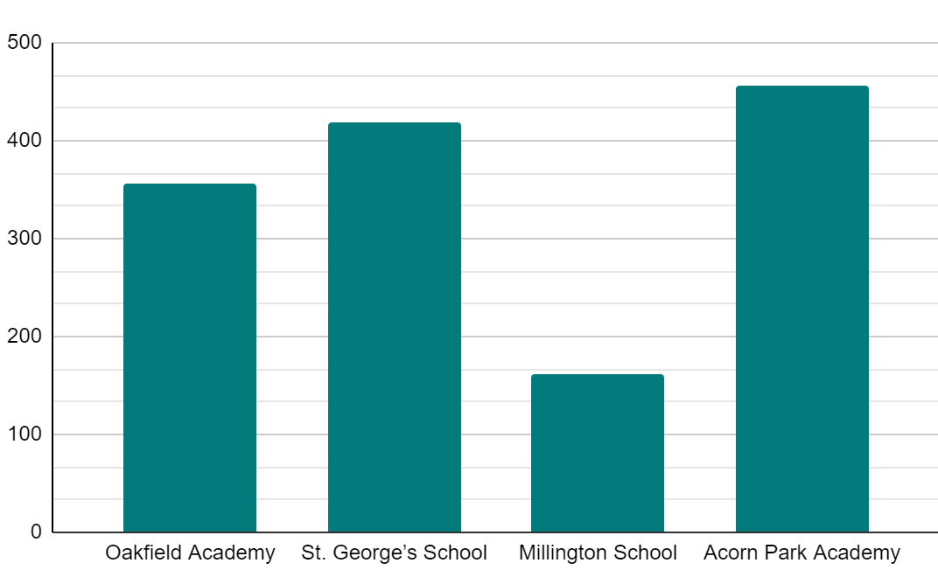
Using bar charts in a data investigation
Number of students who eat the recommended number of fruit and vegetables per day at four secondary schools
Which school do you think the local authority is concerned about and why?
Frequency
Millington School, as the other three are fairly similar.
Schools

Slide 26
Using bar charts in a data investigation
They decide to collect some further data at each school.
What data do you think they might collect?
You may have considered:
which fruit and vegetables they are eating
breakdown by year group
where they are eating the fruit and vegetables (i.e. home or school)

Slide 27
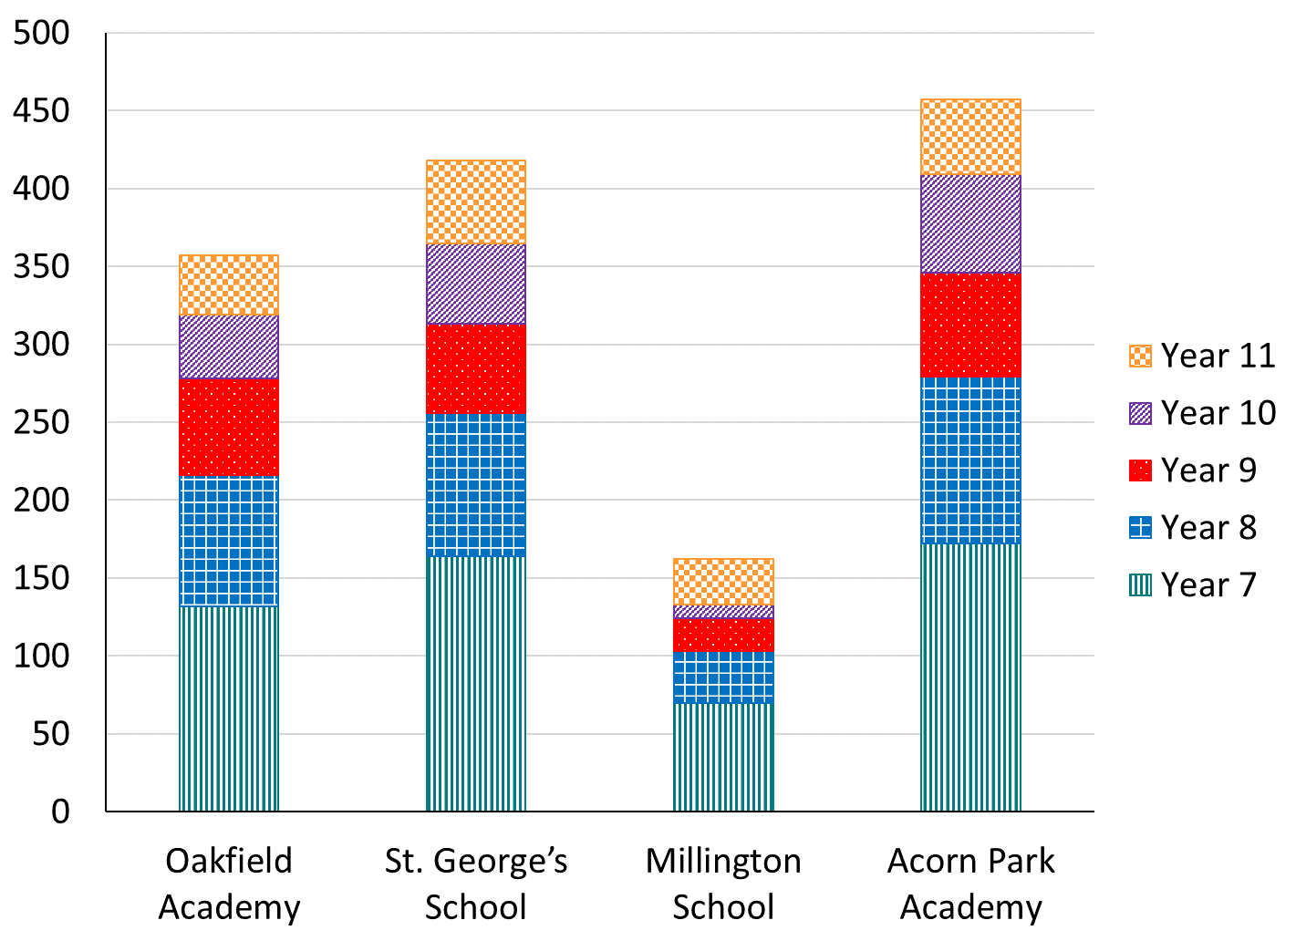
Using bar charts in a data investigation
They collect the data by year group at each school.
This stacked bar chart allows the data to be seen by year group within each school.
Frequency
School

Slide 28
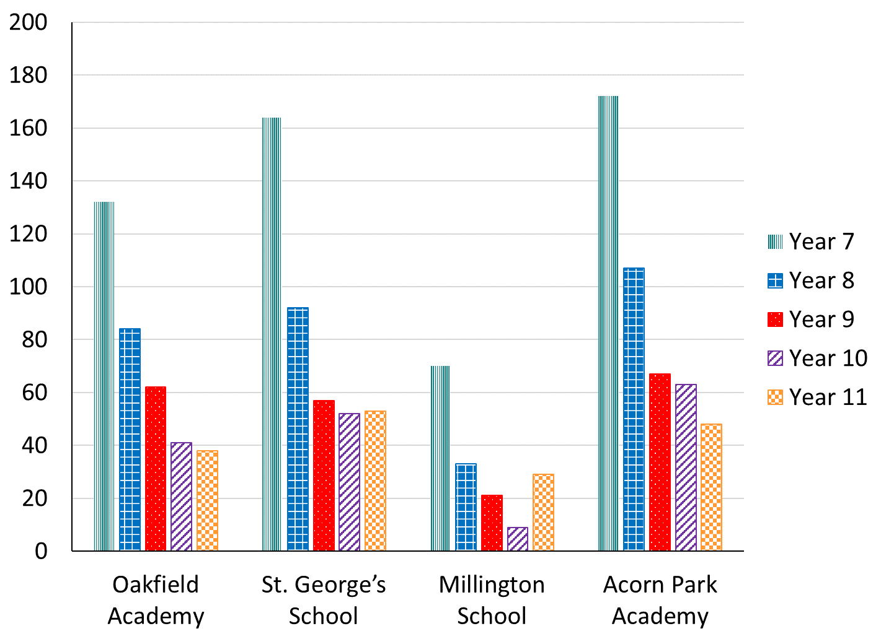
Using bar charts in a data investigation
They collect the data by year group at each school.
This comparison bar chart allows us to compare the year groups between schools more easily.
Frequency
Which school’s year 8 students are eating the recommended fruit and veg the most?
Acorn Park Academy
School

Slide 29
Using bar charts in a data investigation
They collect the data by year group at each school.
Frequency
Frequency
School
School
Using this further data, which year group do you think the local authority will focus their efforts on at Millington School?
Year 10

Slide 30
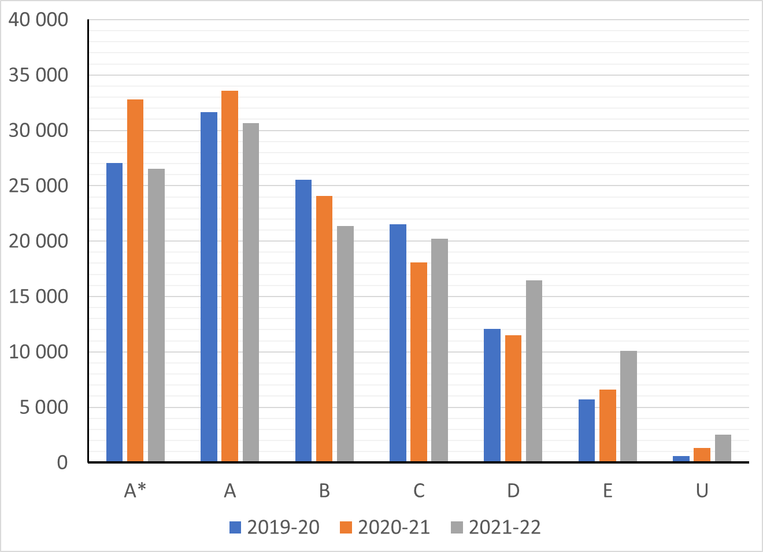
Using bar charts in a data investigation
This comparison bar chart shows the number of each grade awarded in A levels in England.
Which grade has decreased in frequency every year?
Frequency
Grade B
Grades

Slide 31
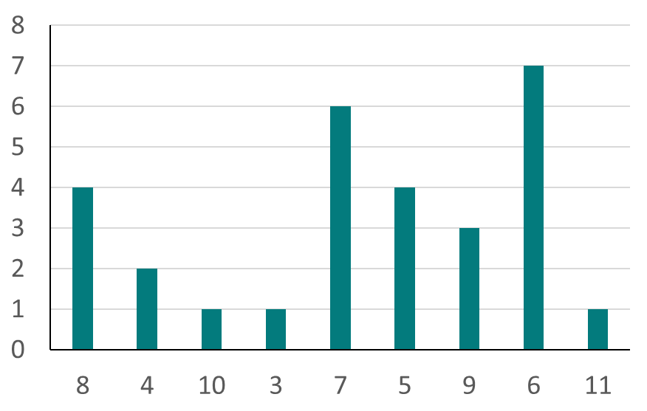
Using bar charts in a data investigation
This data is about the number of children with each shoe size in a year 8 class.
The bars are in a random shoe size order. Does it matter?
Frequency
You can clearly see that size 6 is the most common.
Shoe size

Slide 32
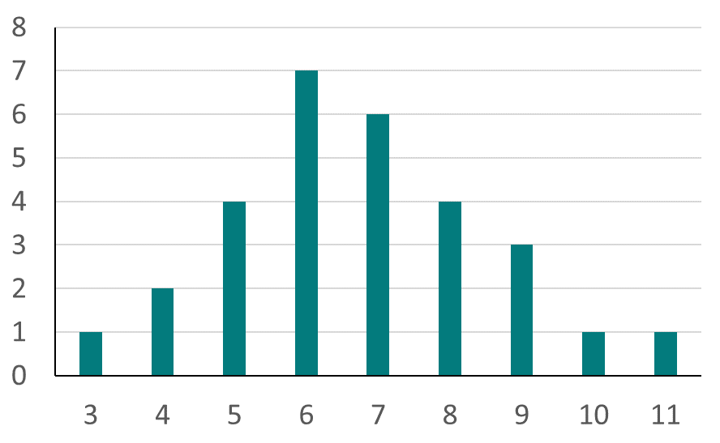
Using bar charts in a data investigation
If we order the bars from smallest to largest, is it clearer?
Frequency
This allows you to see the distribution more easily.
As year 8 students are the same age, we would expect this shape.
Shoe size

Slide 33
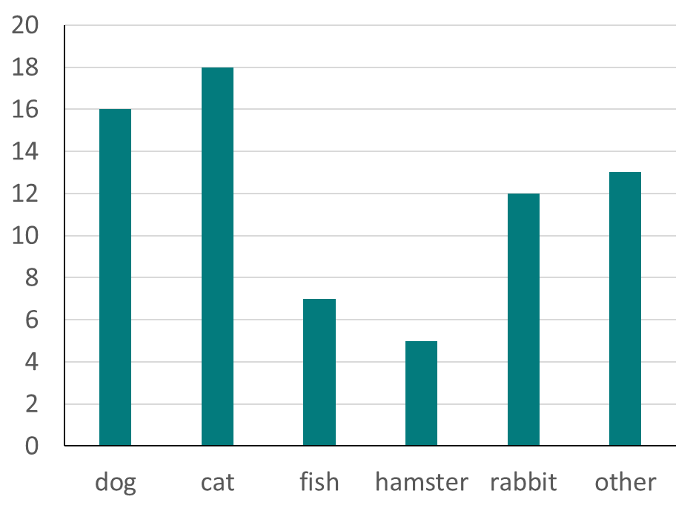
Using bar charts in a data investigation
Often the data collected is about non-numerical data.
For example: colours, animals, food etc.
Frequency
Should the bars be in some sort of order?
No, this type of data often doesn’t have a relevant order.
Pets

Slide 34

Using bar charts in a data investigation
The bars of a bar chart always need to be in a particular order.
The same data is being represented, regardless of order.
Sometimes there is a known relevant order, but not always.

Slide 35
Using bar charts in a data investigation
Decide whether each data set should be ordered or not.
Colours of karate belts
Types of animals at a zoo
Types of pen
Movie genres
Clothing sizes

Slide 36
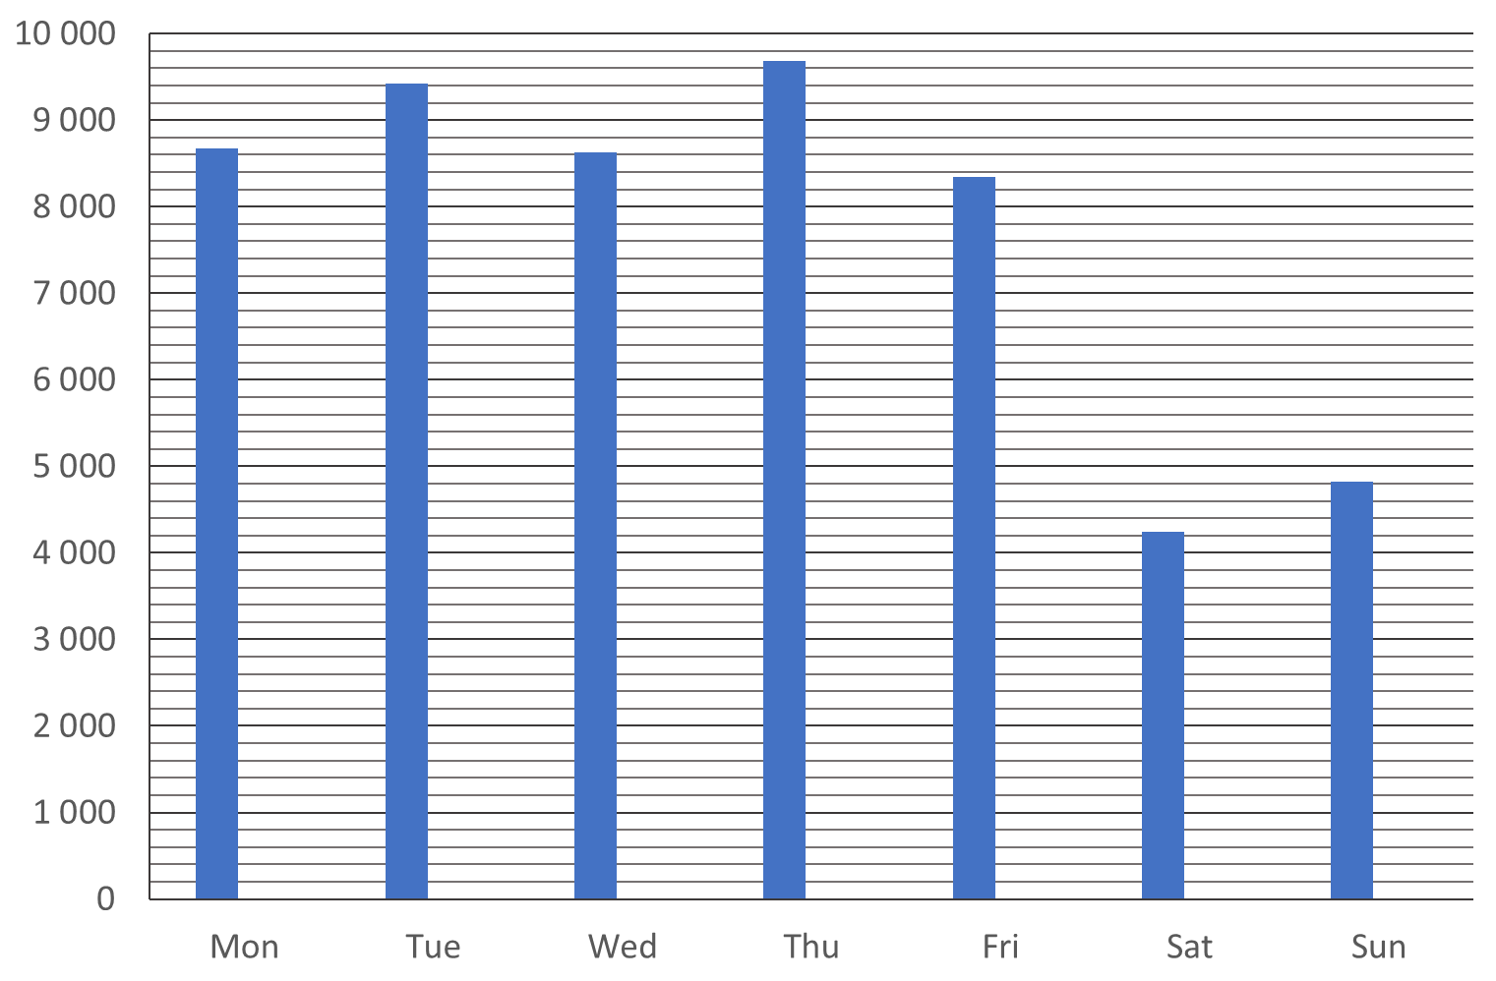
Using bar charts in a data investigation
Jacob wants to see if there is any trend to his step count. He collects data over a two week period. Week one is displayed,
add week two to the bar chart.
Week 2
Mon | 8 600
Tue | 8 900
Wed | 8 700
Thu | 9 300
Fri | 9 100
Sat | 4 500
Sun | 4 700
Frequency
Days

Slide 37
Using bar charts in a data investigation
Jacob wants to see if there is any trend to his step count. He collects data over a two week period. Week one is displayed.
What comments can you make regarding Jacob’s daily step count? Justify your comments.

Slide 38
Using bar charts in a data investigation
Decide whether each data set should be ordered or not.
Colours of karate belts
Animals at a zoo
Types of pen
Movie genres
Clothing sizes
Ordered as there is a ranking system.
Not ordered
Not ordered
Not ordered
Ordered e.g. XS, S, M, L, XL, XXL

Slide 39
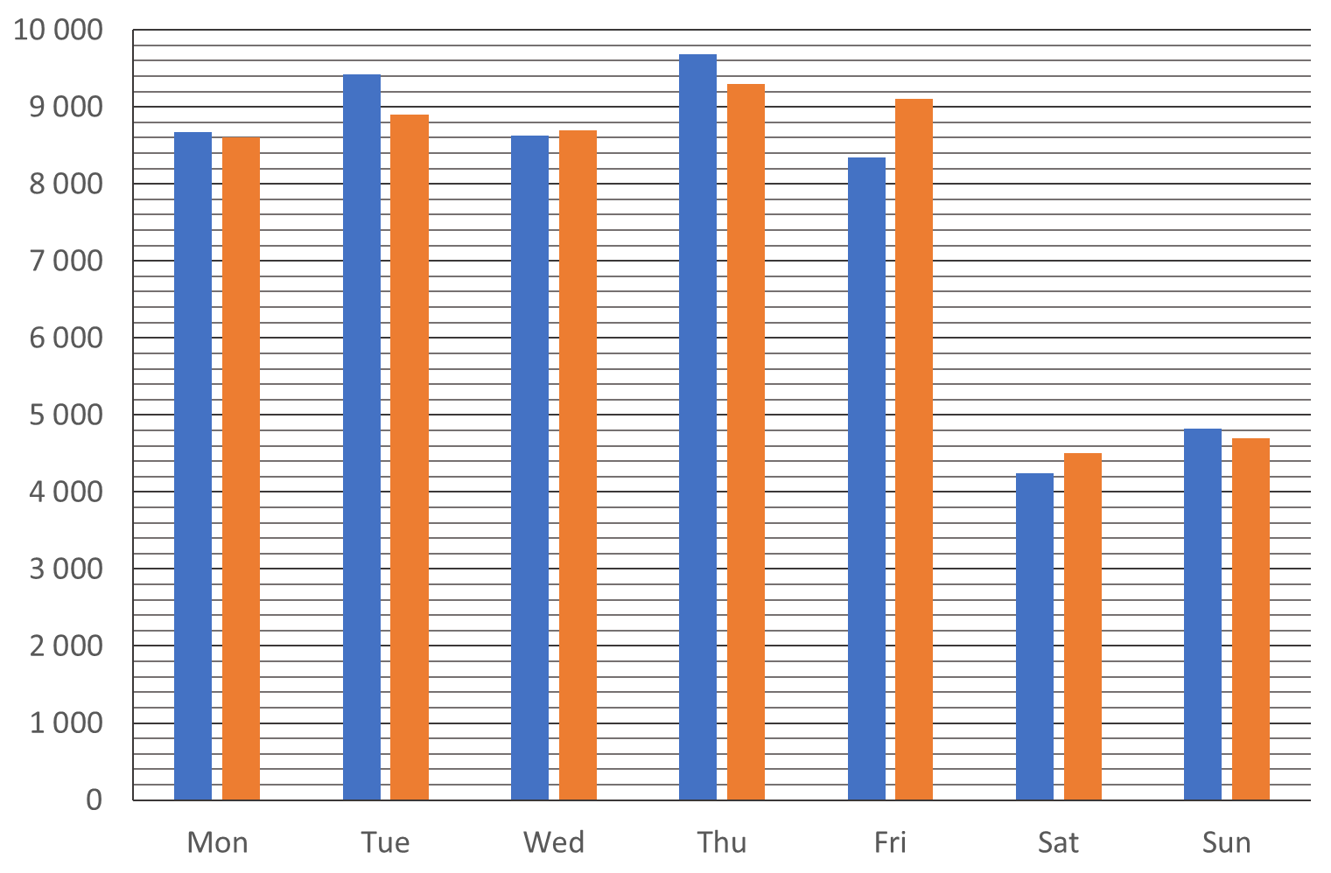
Using bar charts in a data investigation
Jacob wants to see if there is any trend to his step count. He collects data over a two week period. Week one is displayed,
add week two to the bar chart.
Week 2
Mon | 8 600
Tue | 8 900
Wed | 8 700
Thu | 9 300
Fri | 9 100
Sat | 4 500
Sun | 4 700
Frequency
Days

Slide 40
Using bar charts in a data investigation
2) Jacob wants to see if there is any trend to his step count. He collects data over a two week period. Using your bar chart:
b) What comments can you make regarding Jacob’s daily step count? Justify your comments.
You may have responded with:
His daily step count is lower at the weekend. This may be because he isn’t walking around a school building.
The daily step counts are similar between the two weeks, this may be due to him following the same timetable during the week and the same hobbies at the weekend.

Slide 41
Securing constructing bar charts by hand
Bar charts are a data representation.
They are fairly simple to understand.
The vertical axis represents frequency and the bars have equal gaps between them.
If the data has a relevant order, the bars should follow that order.

Slide 42

© Oak National Academy 2023.
Produced in partnership with Mathematics in Education and Industry.
Licensed on the Open Government Licence v3.0, except where otherwise stated. See Oak terms and conditions.

